Slide 1
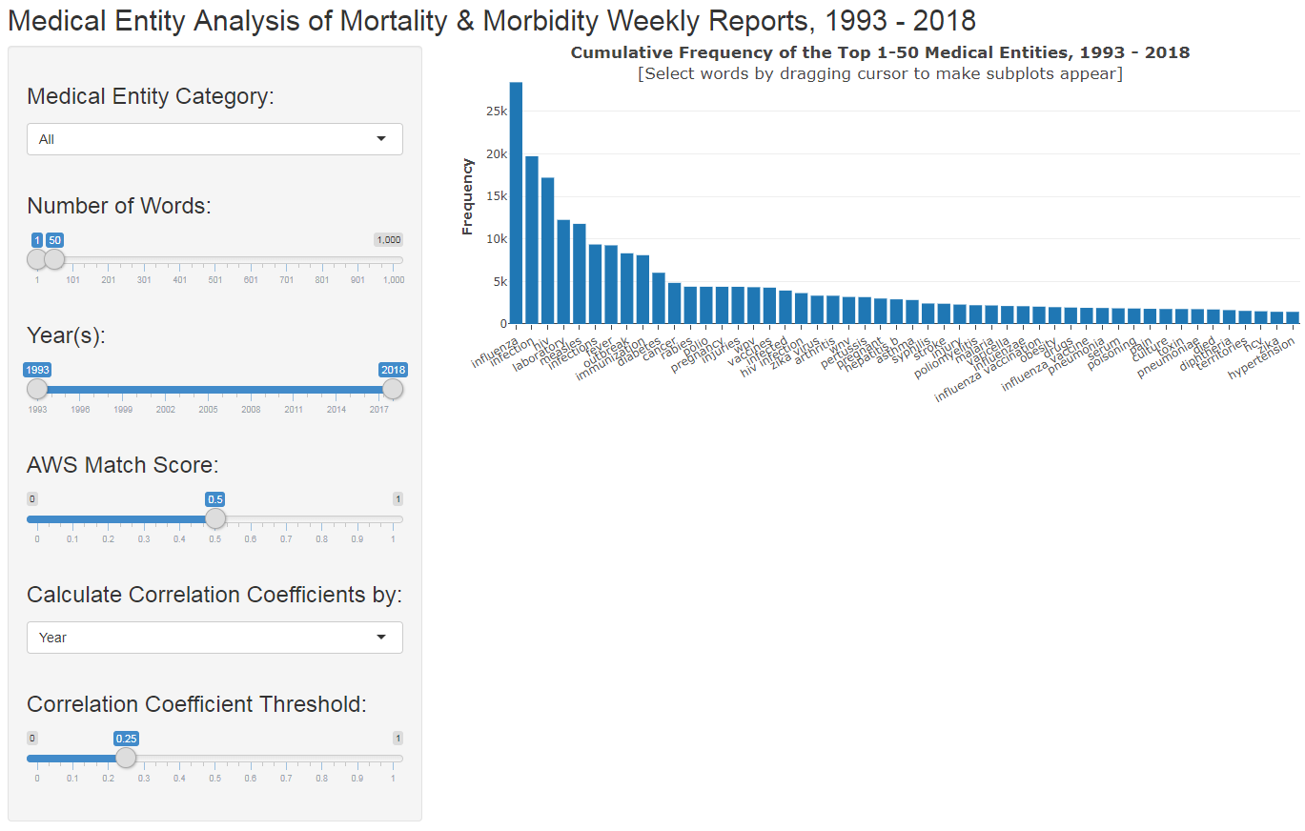
Figure 1: Initial, default view of Shiny app upon first loading. Displays the main plot (a histogram) showing the cumulative frequency of extracted medical entities.

Slide 2
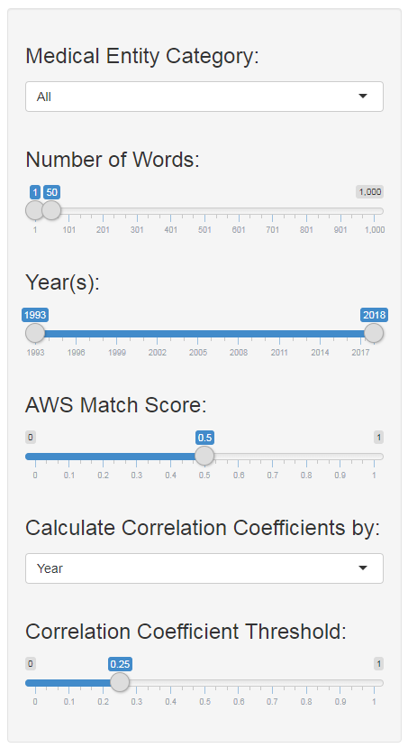
Allows for selection of type of medical entity; choices include: all, medications, medical conditions, tests/treatments/procedures
Defines the number of words included in the visualizations
Limits the years (ie—date of MMWR issue) included
Confidence score provided by Amazon’s Comprehend Medical; higher number indicates a better match to medical entity
Defines the unit (year, quarter, month, issue) for calculating the correlations coefficient
Sets a threshold for the correlations displayed on the correlation matrix (higher thresholds mean the two terms appear more often together in the defined unit)
Figure 2: Detailed view of data selection tools

Slide 3
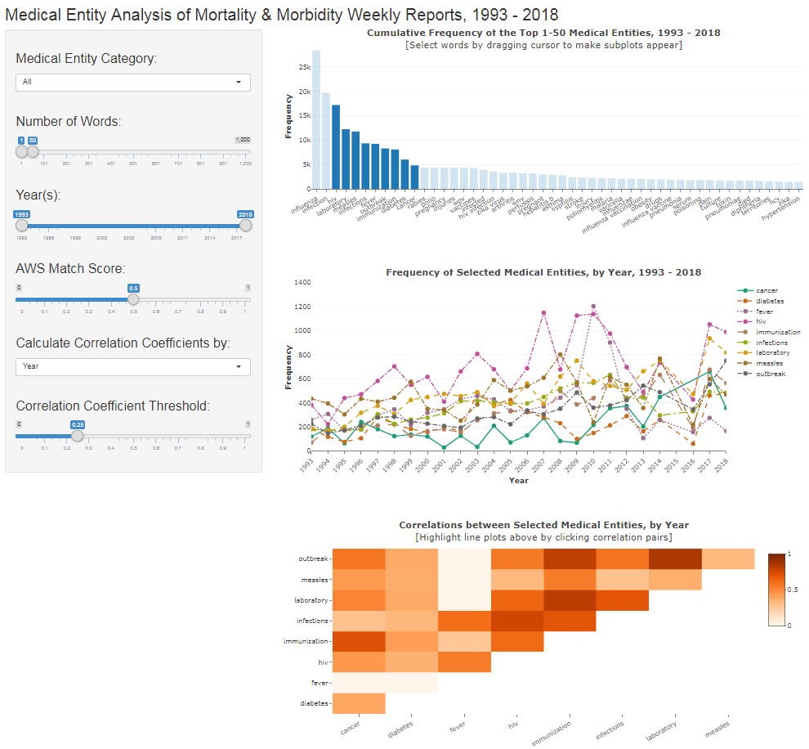
Main plot
Subplot 1
Subplot 2
Figure 3: Overview of main plot (top histogram) and two subplots. Selecting a subgroup of the medical entities from the top histogram creates subplots for those selected entities.

Slide 4
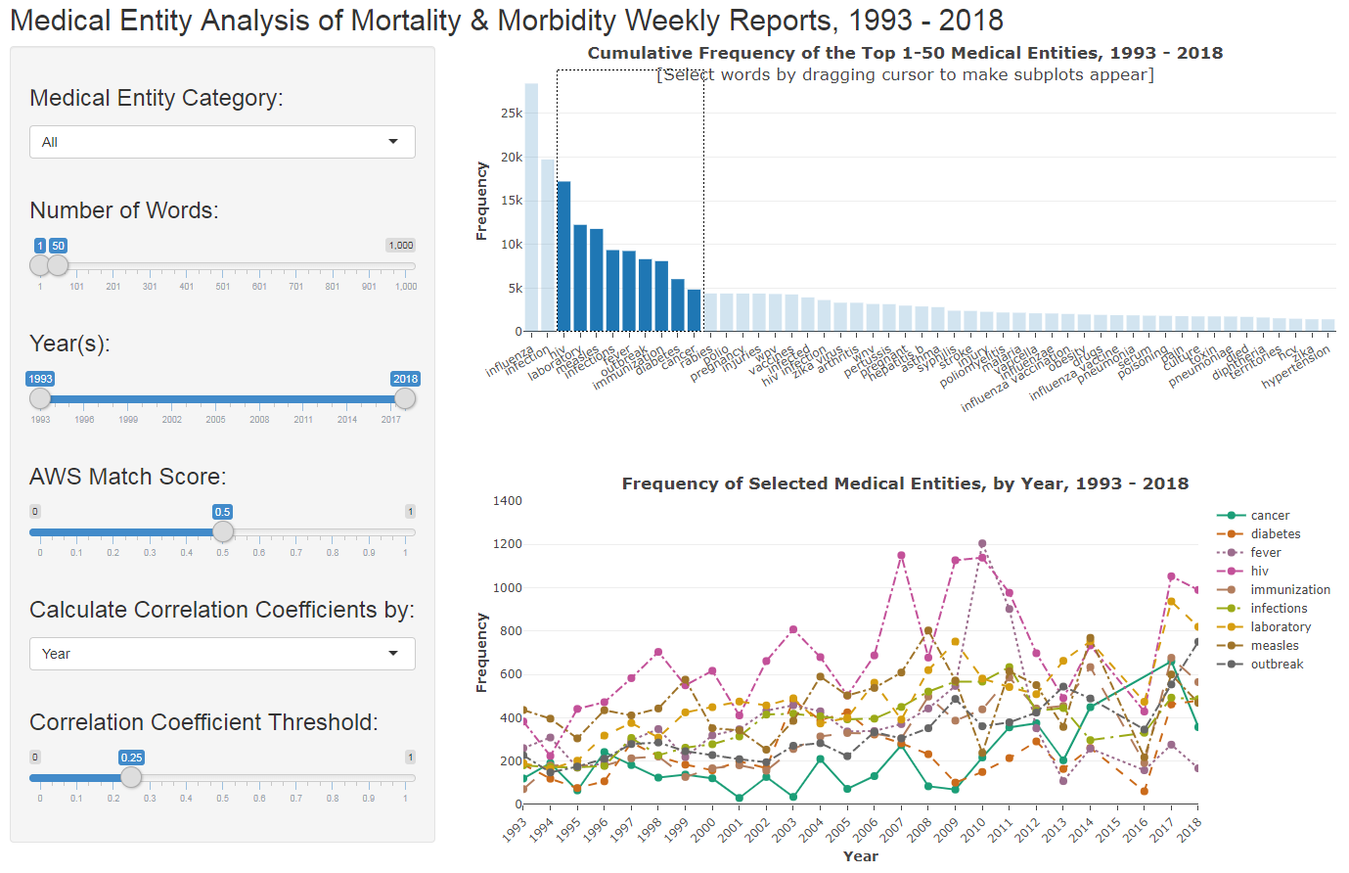
Figure 4: The first subplot is a line plot showing the frequency of the selected entities over the selected time period.

Slide 5
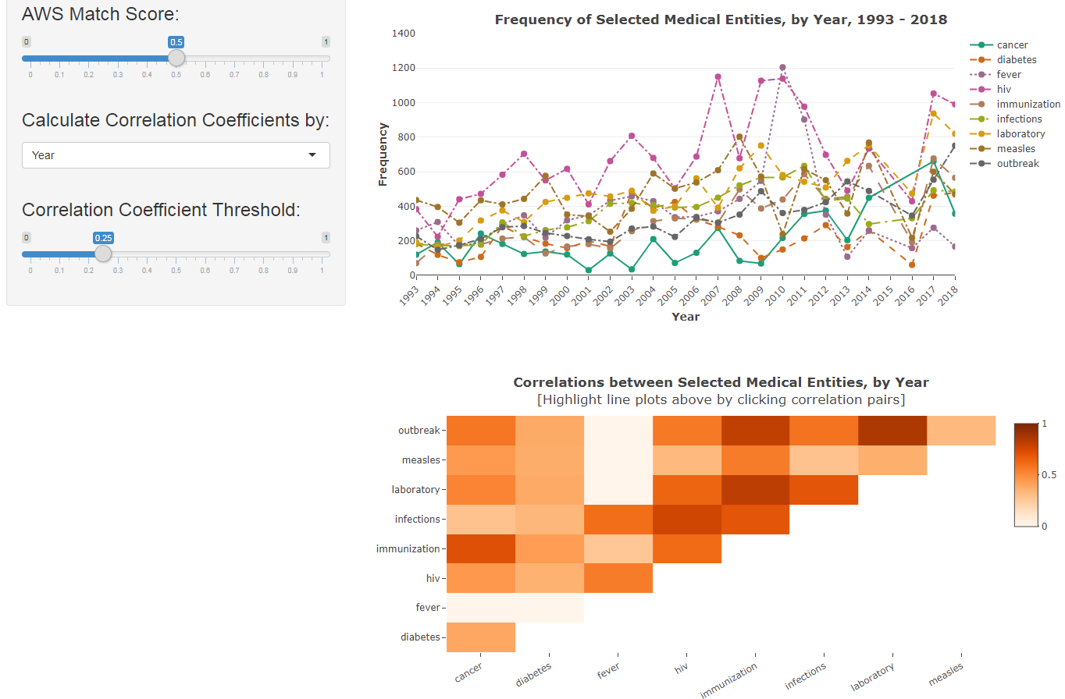
Figure 5: The second subplot is a correlation matrix displaying how highly correlated two terms for the given set of parameters. (Main histogram is cutoff in this screenshot)

Slide 6
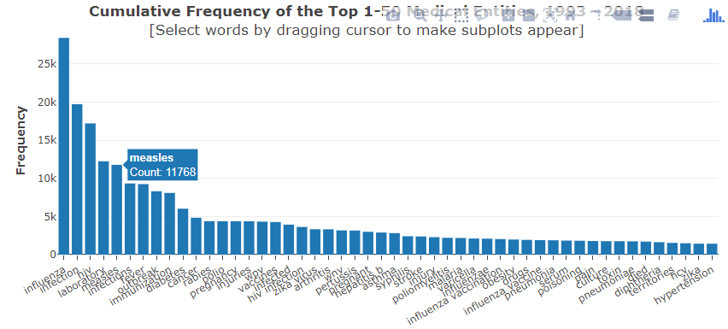
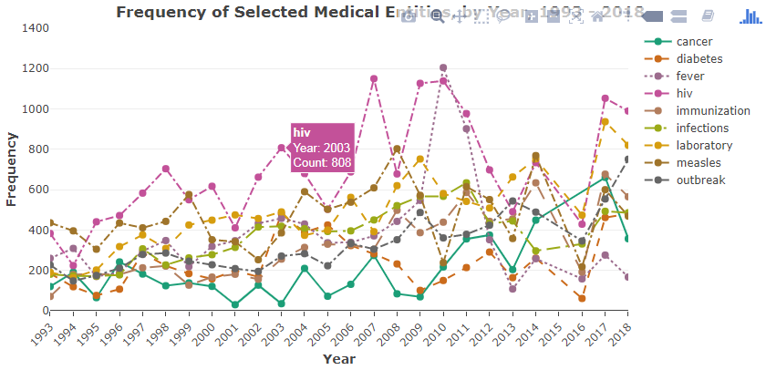
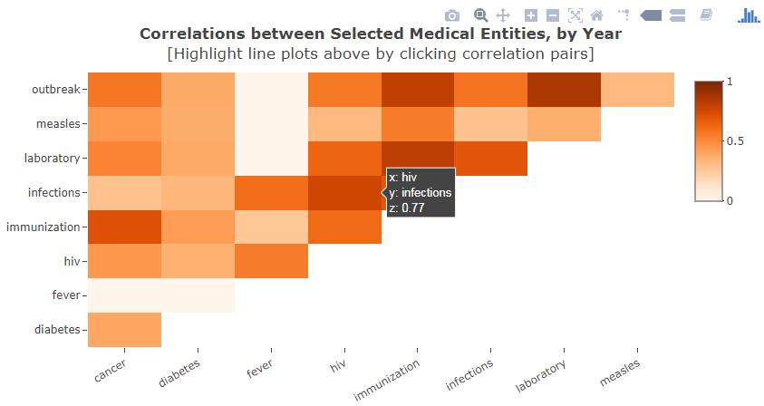
Figure 6: Detailed view showing brushings on each plot.

